Slide 1
Graduate Artificial Intelligence CS 640 Value and Policy Iteration
Jeffrey Considine
jconsidi@bu.edu

Slide 2
Plan for Today
Policies
Value iteration methods
Policy iteration methods

Slide 3
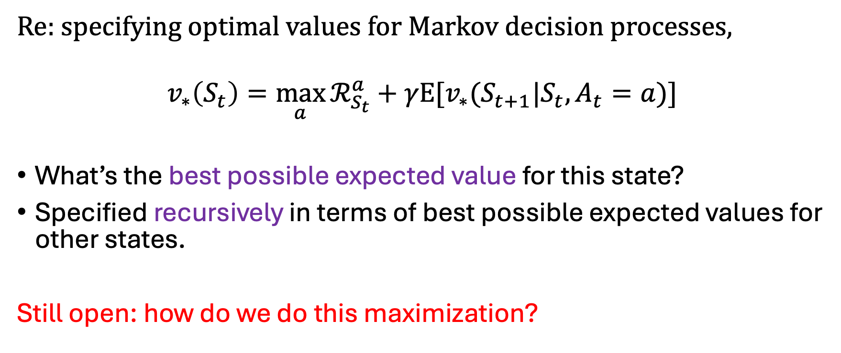

Last Time
Re: specifying optimal values for Markov decision processes,
$$v_{∗}\left(S_{t}\right)=\max_{a}{ℛ_{S_{t}}^{a}+γE[v_{∗}(S_{t+1}|S_{t},A_{t}=a)]}$$
What’s the best possible expected value for this state?
Specified recursively in terms of best possible expected values for other states.
Still open: how do we do this maximization?

Slide 4
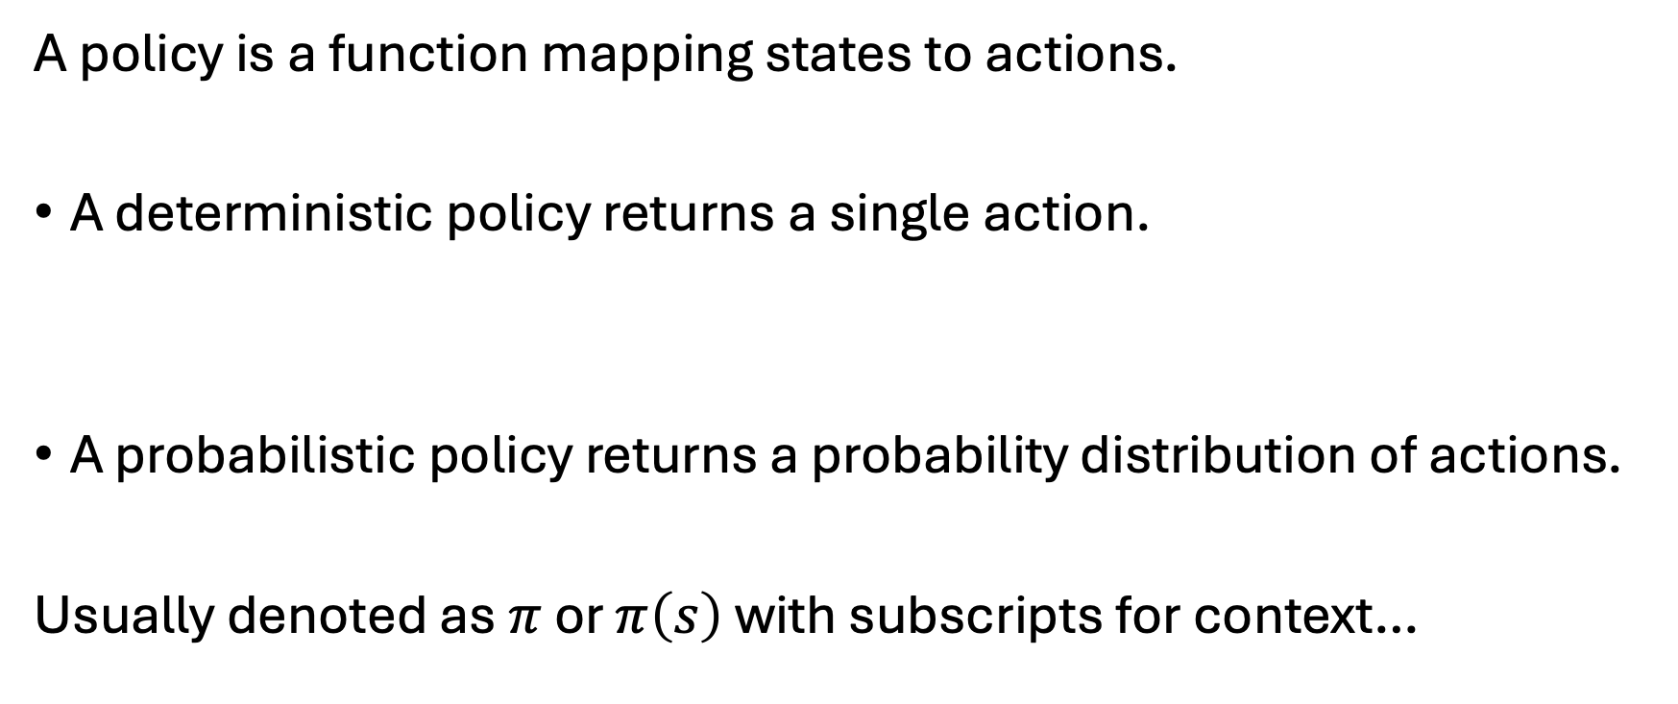
What is a Policy?
A policy is a function mapping states to actions.
A deterministic policy returns a single action.
A probabilistic policy returns a probability distribution of actions.
Usually denoted as $π$ or $π\left(s\right)$ with subscripts for context…

Slide 5
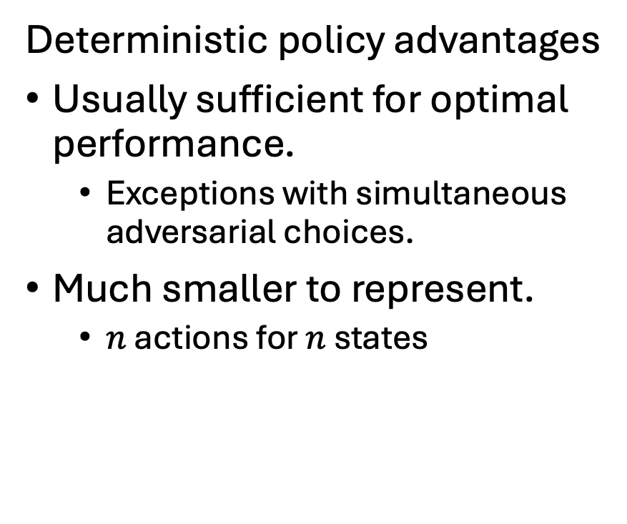
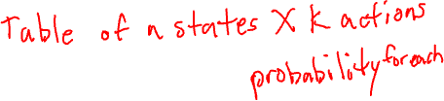
Probabilistic vs Deterministic Policies
Deterministic policy advantages
Usually sufficient for optimal performance.
Exceptions with simultaneous adversarial choices.
Much smaller to represent.
$n$ actions for $n$ states
Probabilistic policy advantages
Can always represent deterministic policies.
All probability on one action.
Often convenient for numerical optimizations.

Slide 6
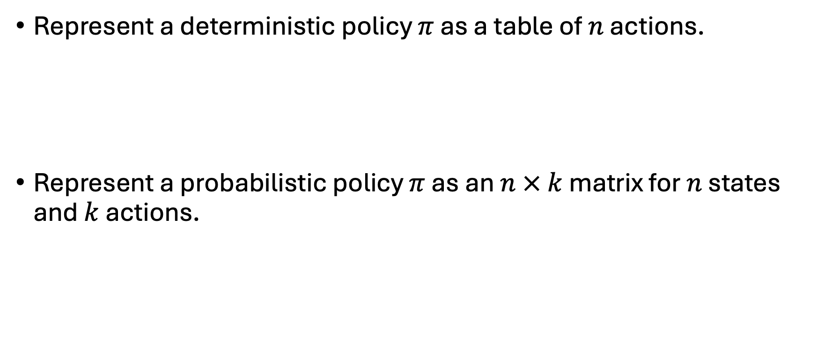
Representing Policies for Finite MDPs
Represent a deterministic policy $π$ as a table of $n$ actions.
Represent a probabilistic policy $π$ as an $n × k$ matrix for $n$ states and $k$ actions.

Slide 7
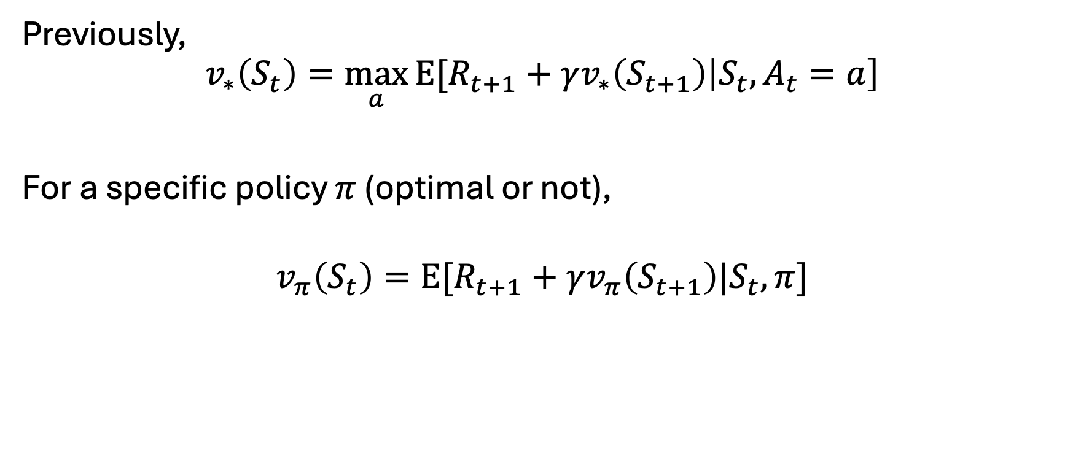
Evaluating Policies for MDPs (take 1)
Previously,
$$v_{∗}\left(S_{t}\right)=\max_{a}{E[R_{t+1}}+γv_{∗}\left(S_{t+1}\right)\left|S_{t},A_{t}=a\right]$$
For a specific policy $π$ (optimal or not),
$$v_{π}\left(S_{t}\right)=E[R_{t+1}+γv_{π}\left(S_{t+1}\right)|S_{t}, π]$$

Slide 8

Evaluating Policies for MDPs (take 2)
Rewrite
$$v_{π}\left(S_{t}\right)=E[R_{t+1}+γv_{π}\left(S_{t+1}\right)|S_{t}, π]$$
to
$$v_{π}\left(S_{t}\right)=E\left[R_{t+1} | S_{t},π\right]+γE[v_{π}\left(S_{t+1})|S_{t}, π\right)]$$

Slide 9
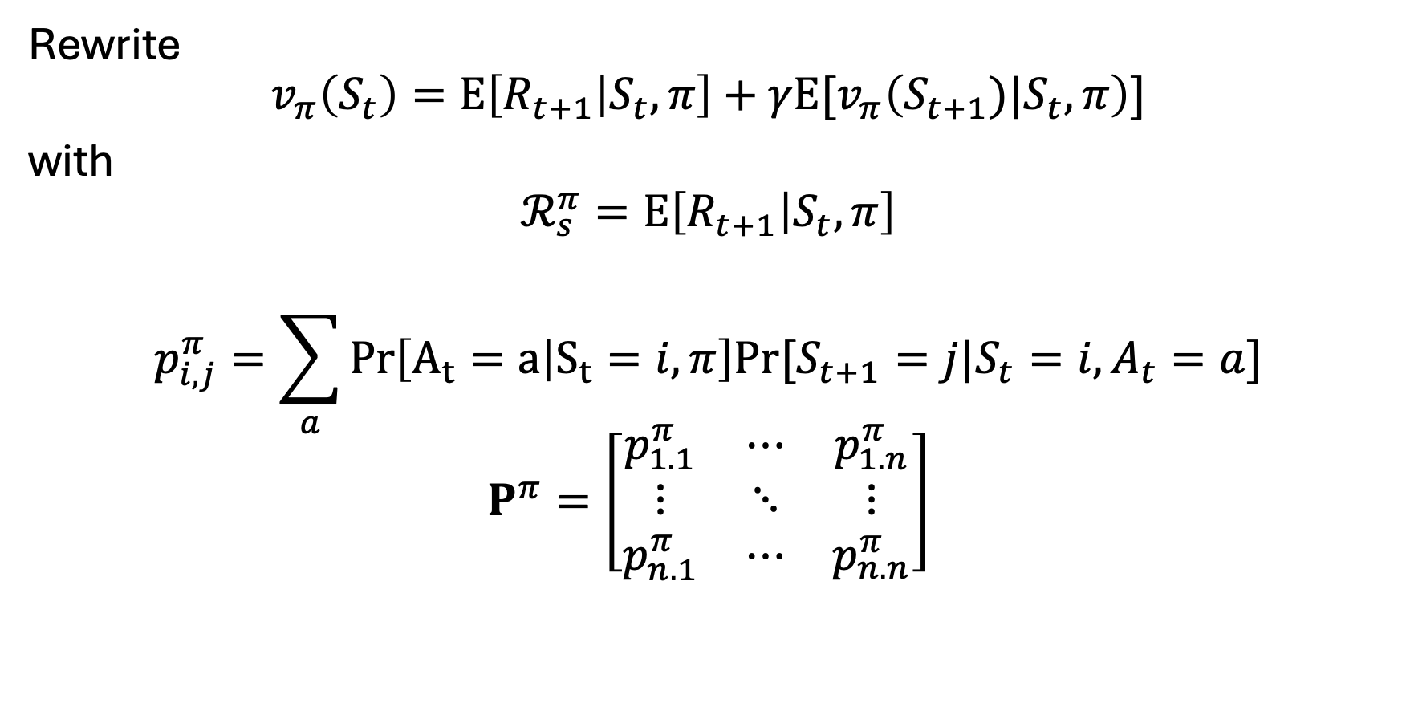
Evaluating Policies for MDPs (take 3a)
Rewrite
$$v_{π}\left(S_{t}\right)=E\left[R_{t+1} | S_{t},π\right]+γE[v_{π}\left(S_{t+1})|S_{t},π\right)]$$
with
$$ℛ_{s}^{π}=E\left[R_{t+1} | S_{t},π\right]$$
$$p_{i,j}^{π}=\sum_{a}{Pr\left[A_{t}=a | S_{t}=i,π\right]Pr⁡[S_{t+1}=j|S_{t}=i,A_{t}=a]}$$
$$P^{π}=\left[\begin{matrix}p_{1.1}^{π} & ⋯ & p_{1.n}^{π} \\ ⋮ & ⋱ & ⋮ \\ p_{n.1}^{π} & ⋯ & p_{n.n}^{π}\end{matrix}\right]$$

Slide 10
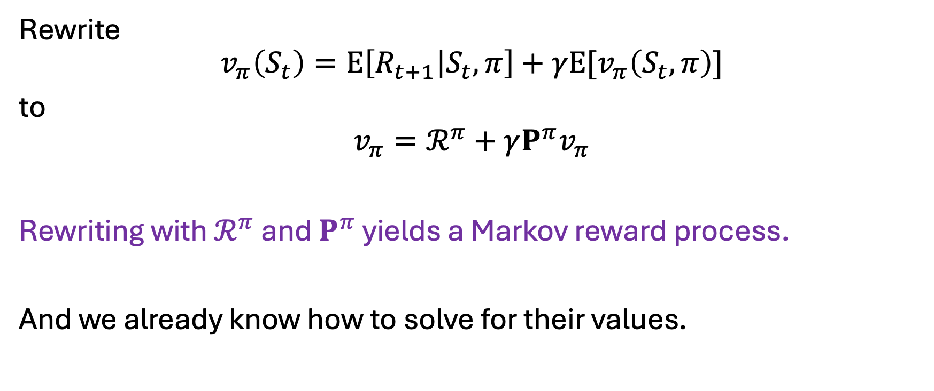

Evaluating Policies for MDPs (take 3b)
Rewrite
$$v_{π}\left(S_{t}\right)=E\left[R_{t+1} | S_{t},π\right]+γE[v_{π}\left(S_{t},π\right)]$$
to
$$v_{π}=ℛ^{π}+γP^{π}v_{π}$$
Rewriting with $ℛ^{π}$ and $P^{π}$ yields a Markov reward process.
And we already know how to solve for their values.

Slide 11
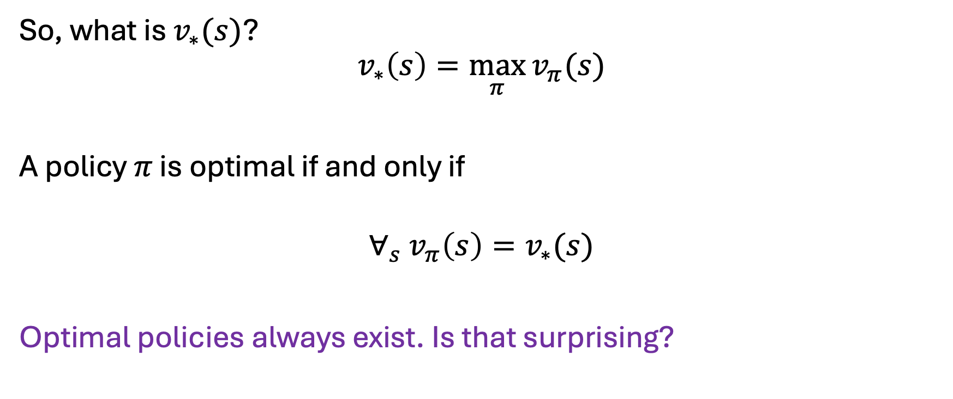
What is an Optimal Policy?
So, what is $v_{∗}(s)$?
$$v_{∗}\left(s\right)=\max_{π}{v_{π}(s)}$$
A policy $π$ is optimal if and only if
$$∀_{s} v_{π}\left(s\right)=v_{∗}(s)$$
Optimal policies always exist. Is that surprising?

Slide 12
Any Questions?
???

Slide 13
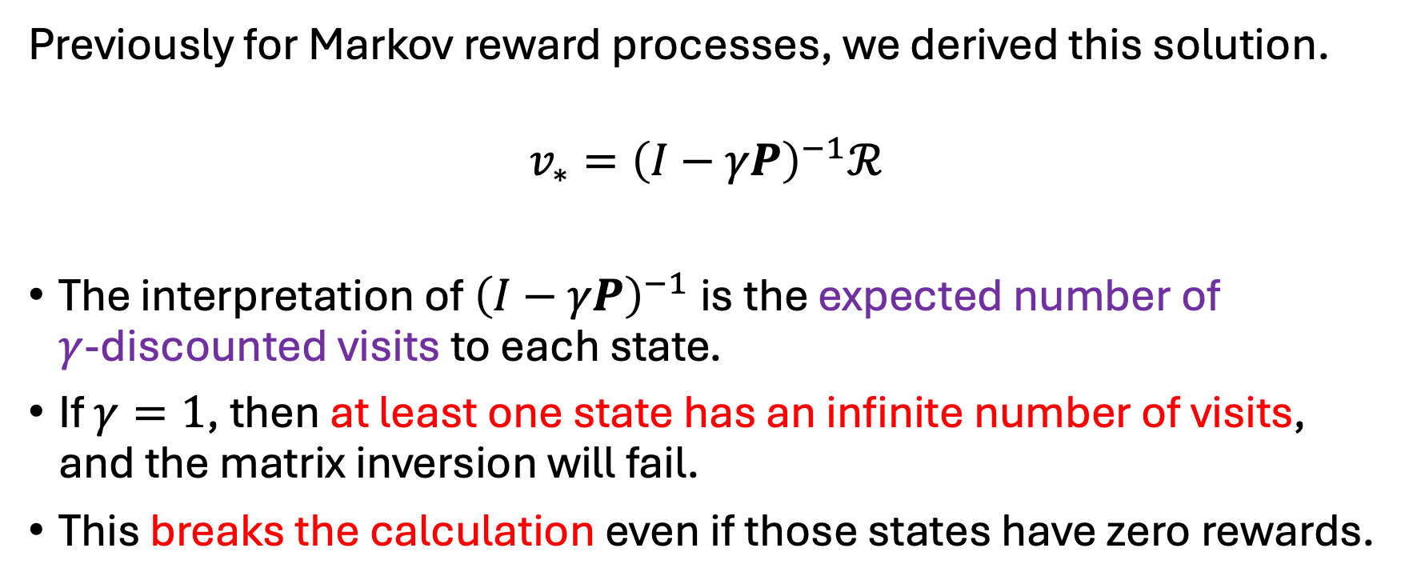

Numerical Problems of Analytical Solution
Previously for Markov reward processes, we derived this solution.
$$v_{∗}={\left(I−γP\right)}^{−1}ℛ$$
The interpretation of ${\left(I−γP\right)}^{−1}$ is the expected number of $γ$-discounted visits to each state.
If $γ=1$, then at least one state has an infinite number of visits, and the matrix inversion will fail.
This breaks the calculation even if those states have zero rewards.

Slide 14
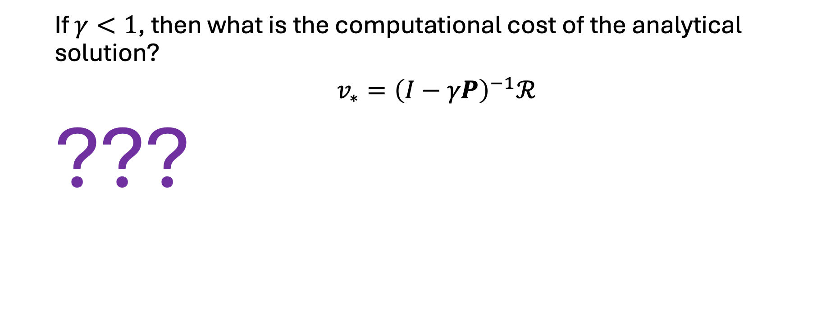
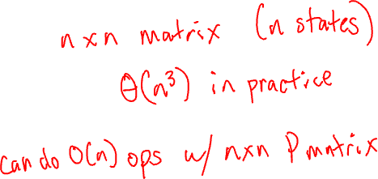
Computational Cost of Analytical Solution
If $γ<1$, then what is the computational cost of the analytical solution?
$v_{∗}={\left(I−γP\right)}^{−1}ℛ$
???

Slide 15
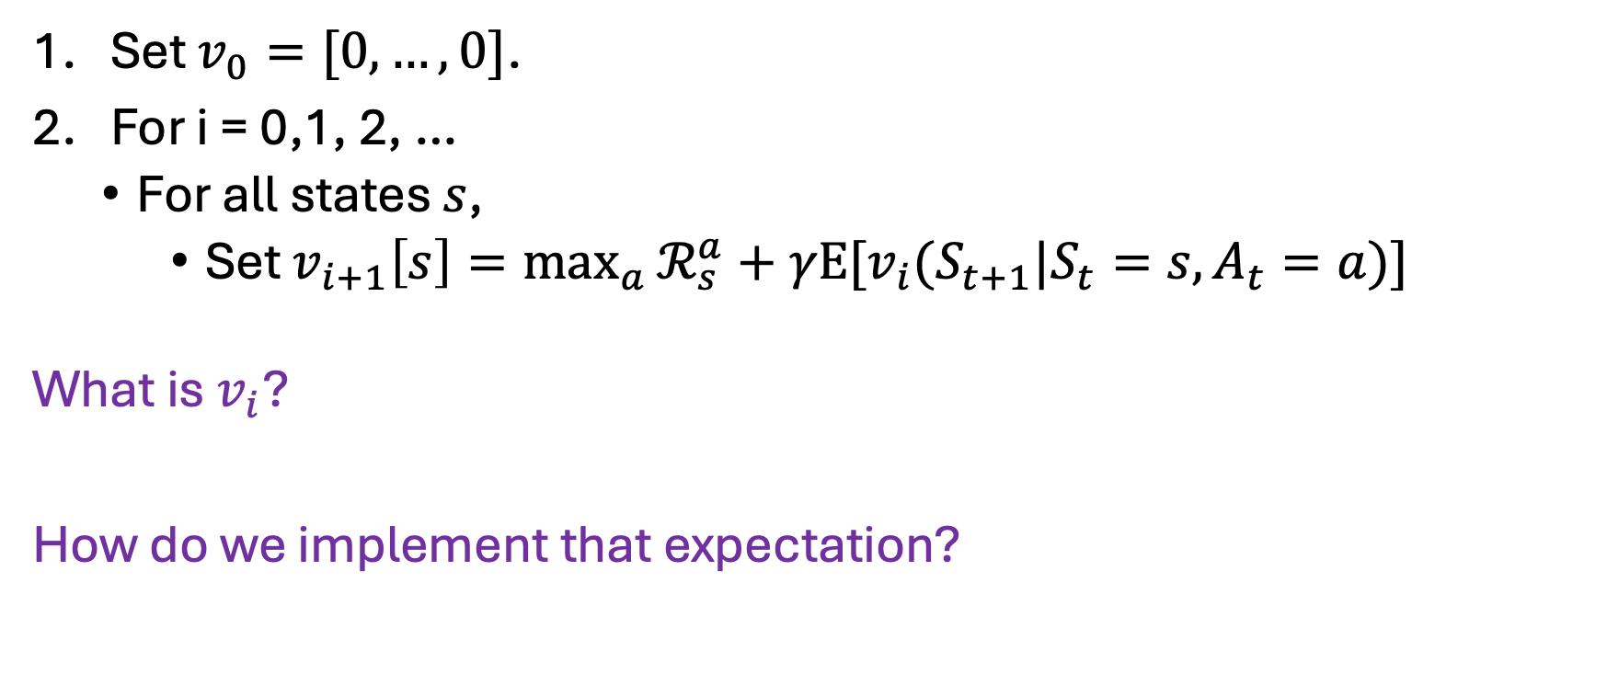
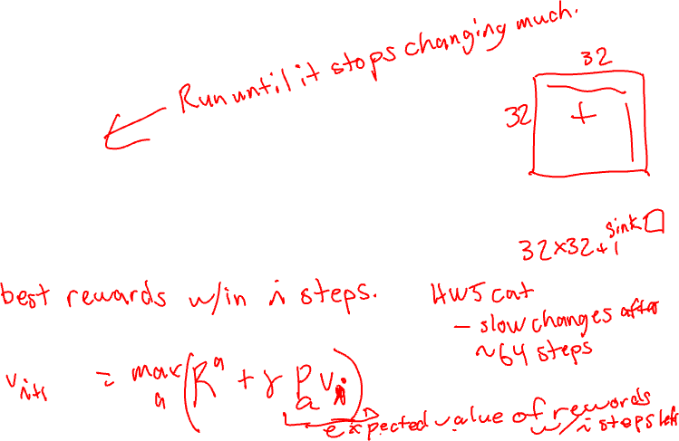
Value Iteration
Set $v_{0}=[0,…, 0]$.
For i = 0,1, 2, …
For all states $s$,
Set $v_{i+1}\left[s\right]=\max_{a}{ℛ_{s}^{a}+γE[v_{i}(S_{t+1}|S_{t}=s,A_{t}=a)]}$
What is $v_{i}$?
How do we implement that expectation?

Slide 16
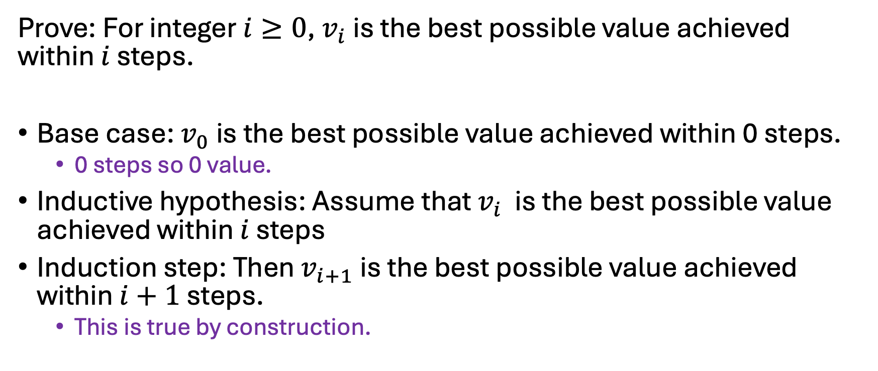
Value Iteration as Fixed Horizon Evaluations
Prove: For integer $i≥0$, $v_{i}$ is the best possible value achieved within $i$ steps.
Base case: $v_{0}$ is the best possible value achieved within 0 steps.
0 steps so 0 value.
Inductive hypothesis: Assume that $v_{i}$ is the best possible value achieved within $i$ steps
Induction step: Then $v_{i+1}$ is the best possible value achieved within $i+1$ steps.
This is true by construction.

Slide 17

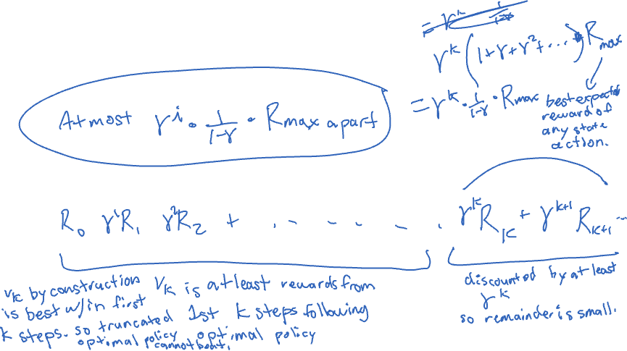
Bounding Distance Values
How close is a given $v_{i}$ to $v_{∗}$?
How much discounted reward is remaining after $i$ steps?

Slide 18

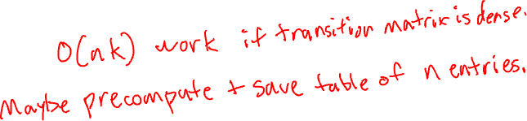
How to Act given (Near) Optimal Values?
For a given $s$, pick the value maximizing action $a$.
$$\underset{a}{argmax}{ℛ_{s}^{a}+γE[v_{i}(S_{t+1}|S_{t}=s,A_{t}=a)]}$$

Slide 19
Any Questions?
???

Slide 20
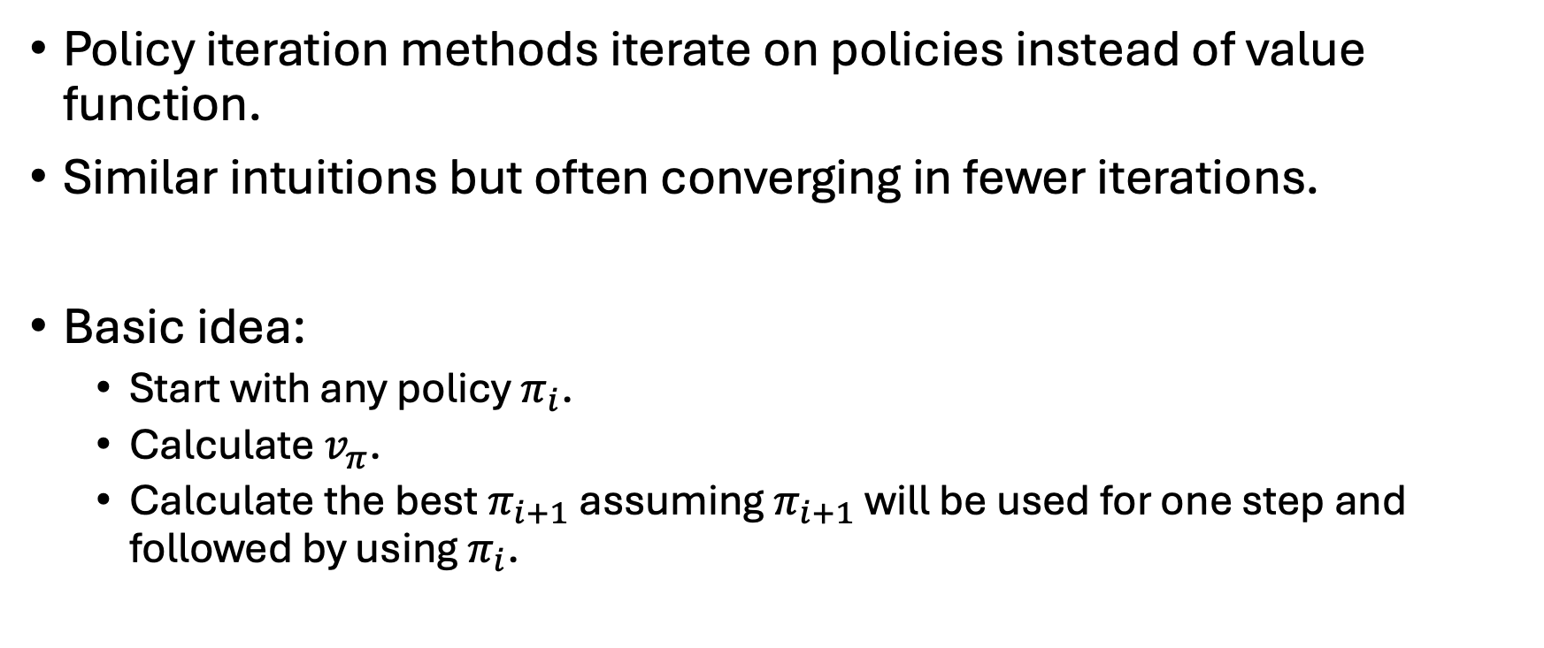
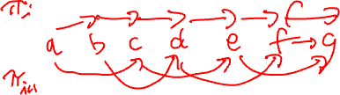
Policy Iteration
Policy iteration methods iterate on policies instead of value function.
Similar intuitions but often converging in fewer iterations.
Basic idea:
Start with any policy $π_{i}$.
Calculate $v_{π}$.
Calculate the best $π_{i+1}$ assuming $π_{i+1}$ will be used for one step and followed by using $π_{i}$.

Slide 21
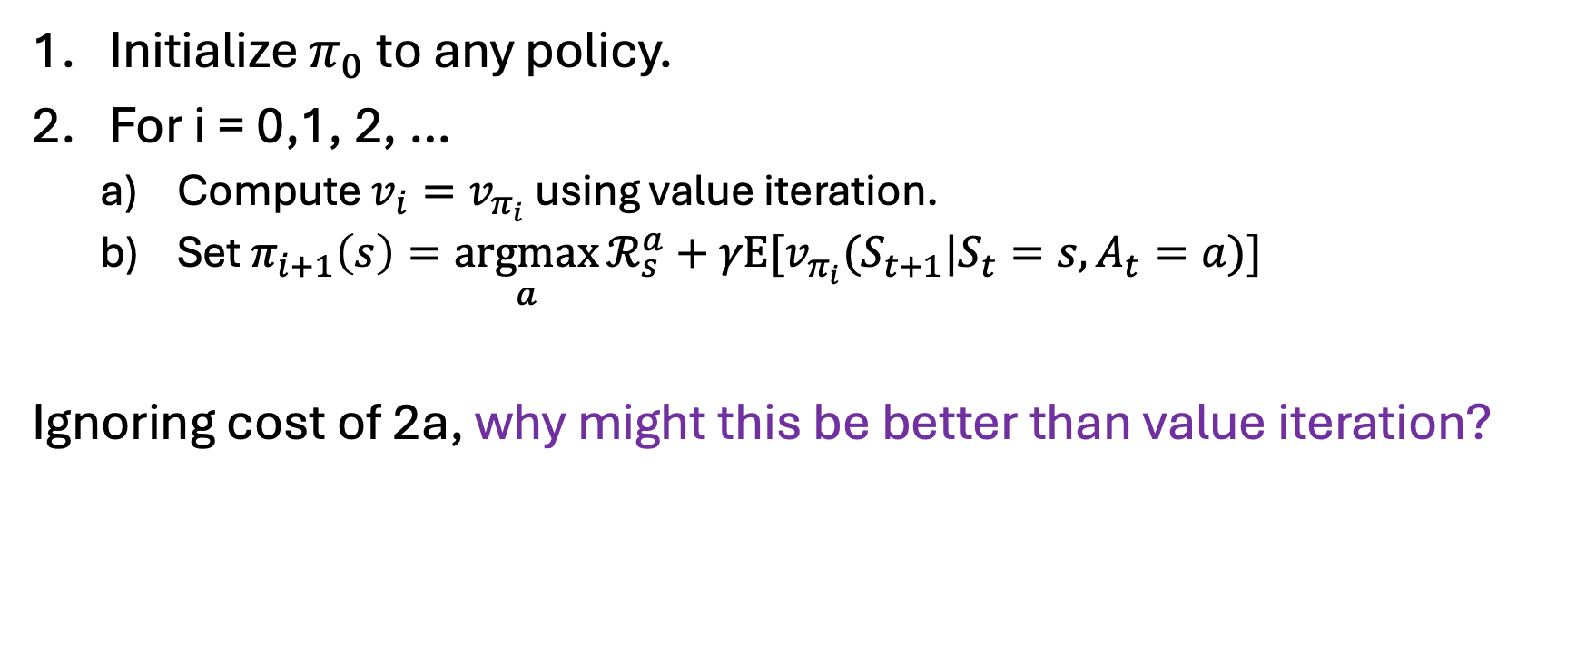
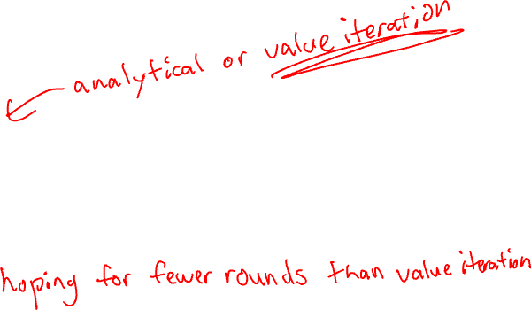
Naïve Implementations of Policy Iteration
Initialize $π_{0}$ to any policy.
For i = 0,1, 2, …
Compute ${v_{i}=v}_{π_{i}}$ using value iteration.
Set $π_{i+1}\left(s\right)=\underset{a}{argmax}{ℛ_{s}^{a}+γE[v_{π_{i}}(S_{t+1}|S_{t}=s,A_{t}=a)]}$
Ignoring cost of 2a, why might this be better than value iteration?

Slide 22
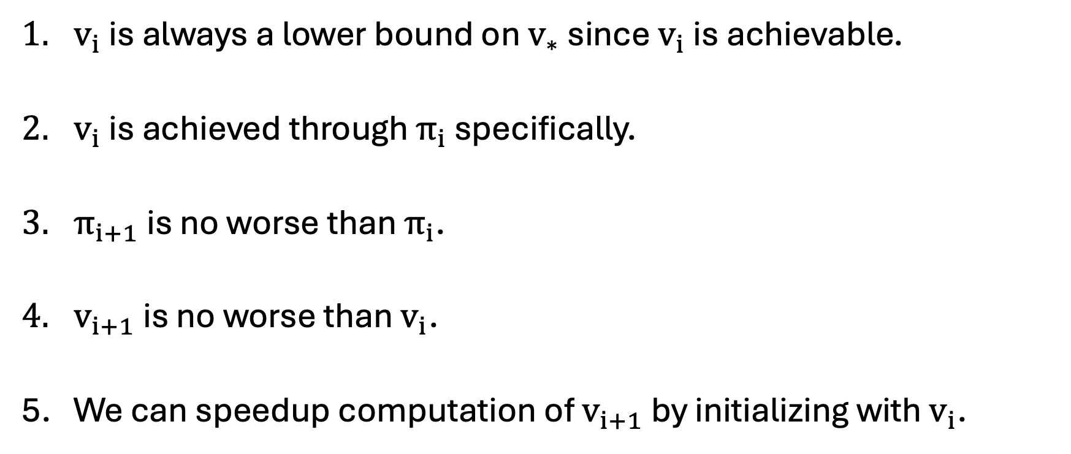
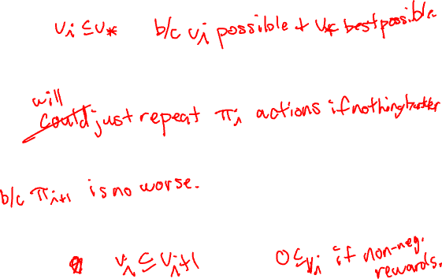
Incremental Value Updates
$v_{i}$ is always a lower bound on $v_{∗}$ since $v_{i}$ is achievable.
$v_{i}$ is achieved through $π_{i}$ specifically.
$π_{i+1}$ is no worse than $π_{i}$.
$v_{i+1}$ is no worse than $v_{i}$.
We can speedup computation of $v_{i+1}$ by initializing with $v_{i}$.

Slide 23
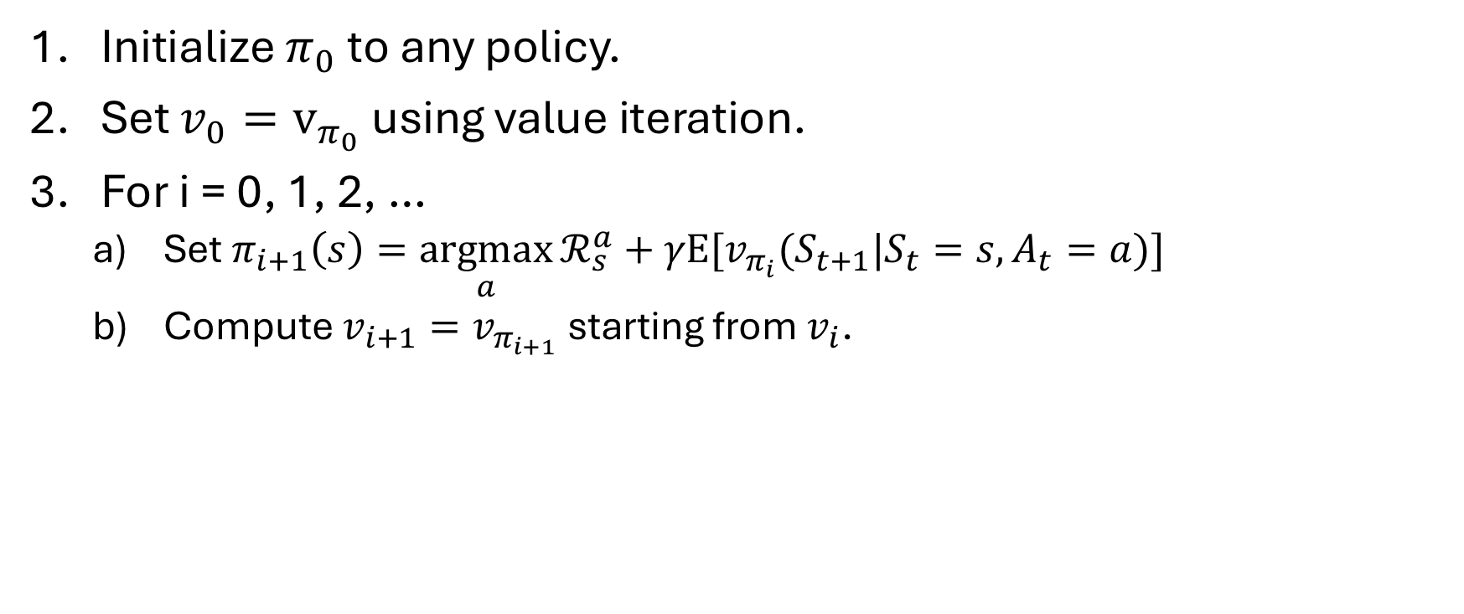
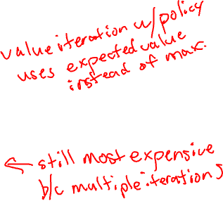
Policy Iteration with Warm Start Values
Initialize $π_{0}$ to any policy.
Set $v_{0}=v_{π_{0}}$ using value iteration.
For i = 0, 1, 2, …
Set $π_{i+1}\left(s\right)=\underset{a}{argmax}{ℛ_{s}^{a}+γE[v_{π_{i}}(S_{t+1}|S_{t}=s,A_{t}=a)]}$
Compute ${v_{i+1}=v}_{π_{i+1}}$ starting from $v_{i}$.

Slide 24
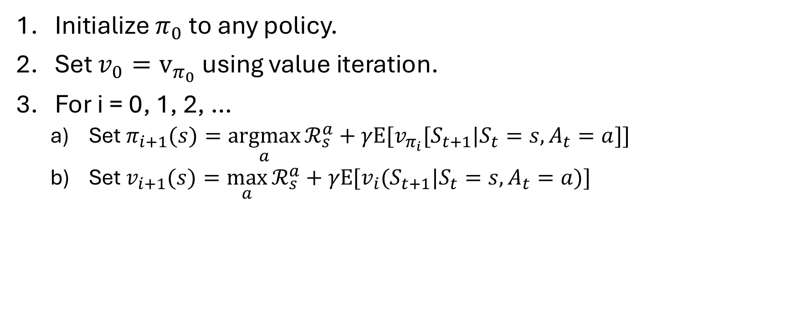
Interleaved Policy and Value Updates
Initialize $π_{0}$ to any policy.
Set $v_{0}=v_{π_{0}}$ using value iteration.
For i = 0, 1, 2, …
Set $π_{i+1}(s)=\underset{a}{argmax}{ℛ_{s}^{a}+γE[v_{π_{i}}[S_{t+1}|S_{t}=s,A_{t}=a]]}$
Set $v_{i+1}(s)=\max_{a}{ℛ_{s}^{a}+γE[v_{i}(S_{t+1}|S_{t}=s,A_{t}=a)]}$

Slide 25
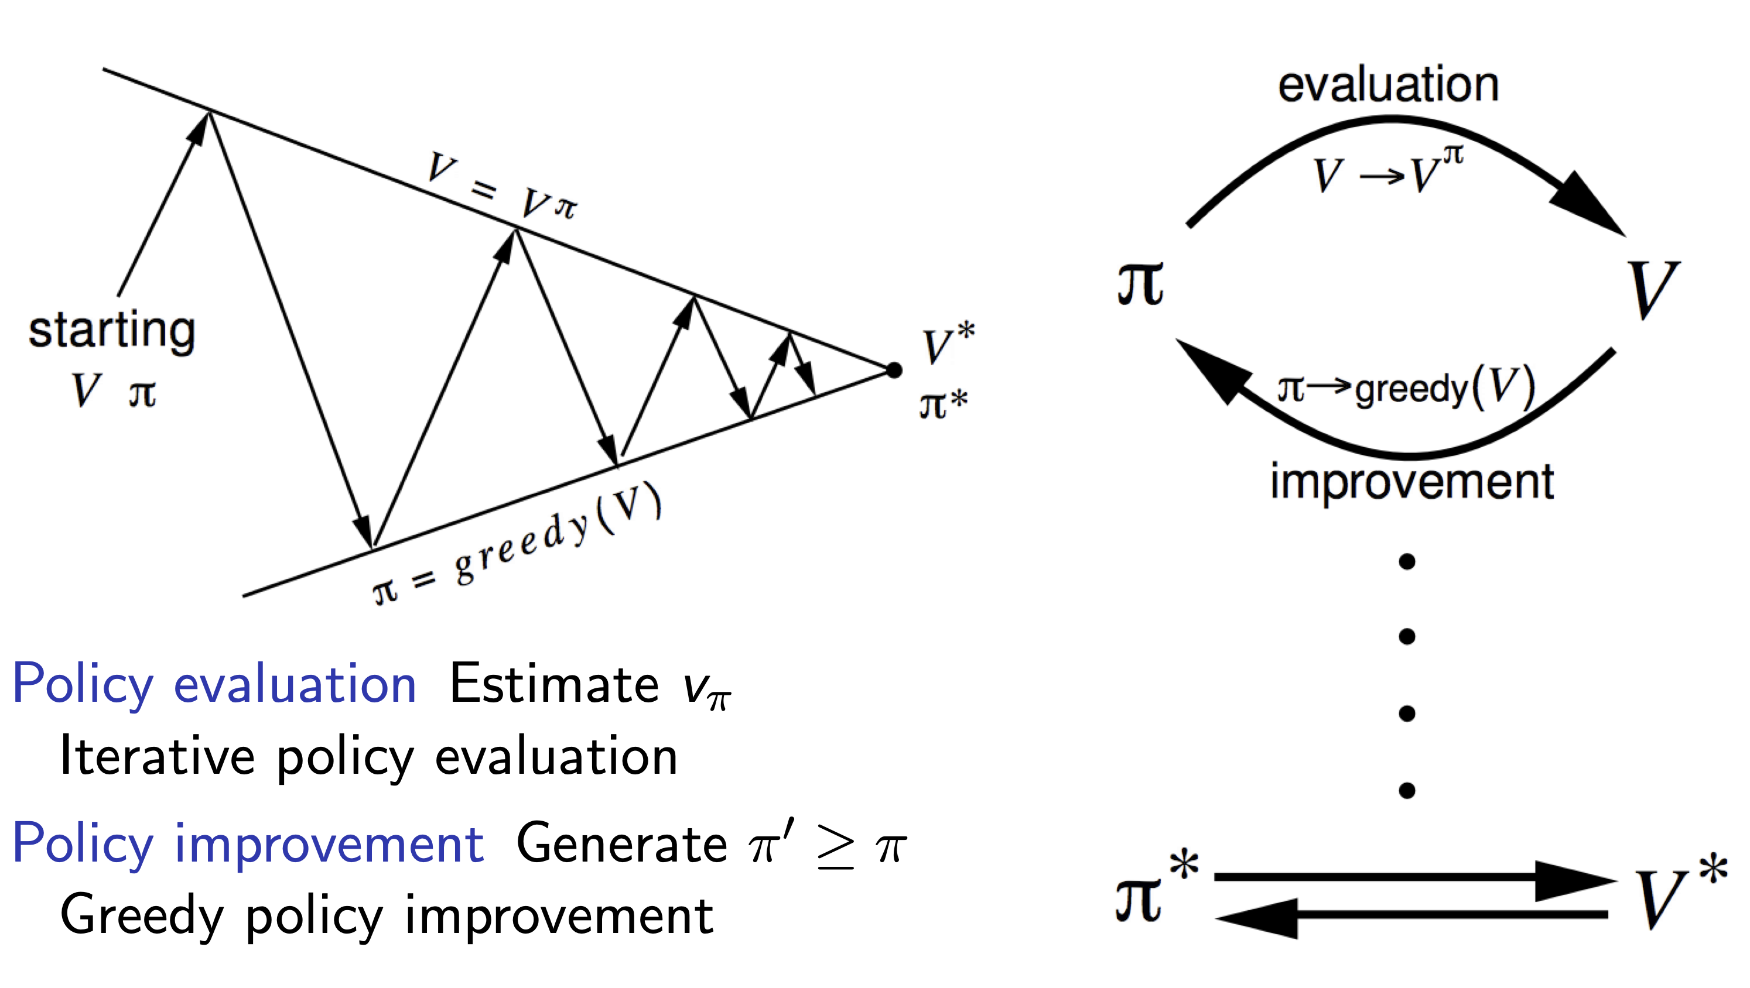
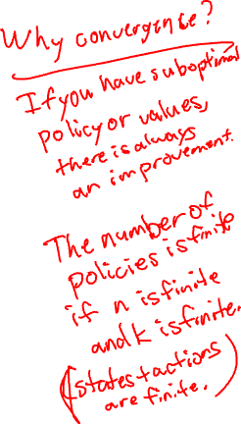
Convergence of Policy Iteration
Figure by David Silver. https://davidstarsilver.wordpress.com/wp-content/uploads/2025/04/lecture-3-planning-by-dynamic-programming-.pdf

Slide 26
Any Questions?
???

